Slide 1
Weekly Update
Jorian Bruslind
Week 10

Slide 2
HyperRail Project
Current Status
Helping Junior Design students assemble systems
3D printing components
Tools / Workstations on campus
Online debugging or in person
Wire purchasing / connector suggestions
Most mechanical work done, ready for students to test

Slide 3
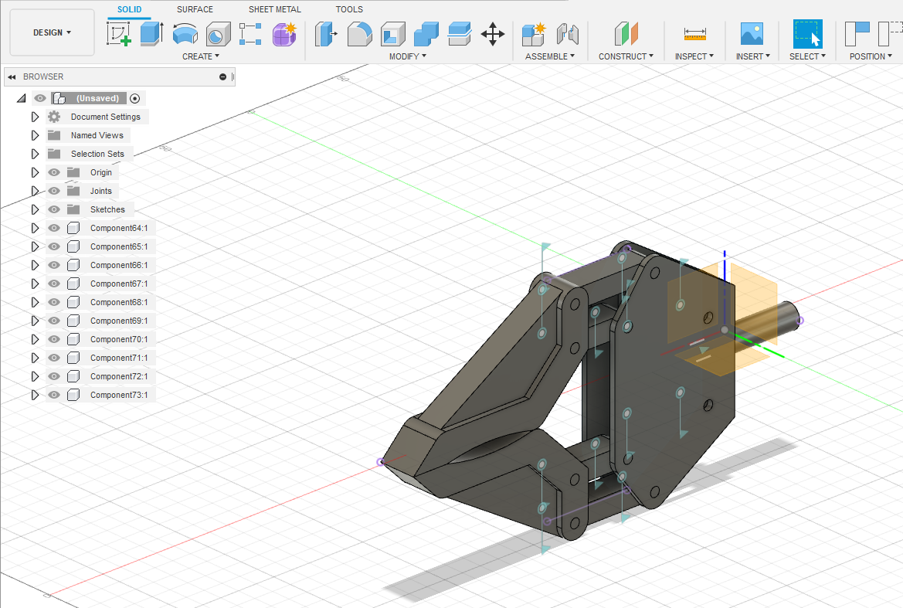
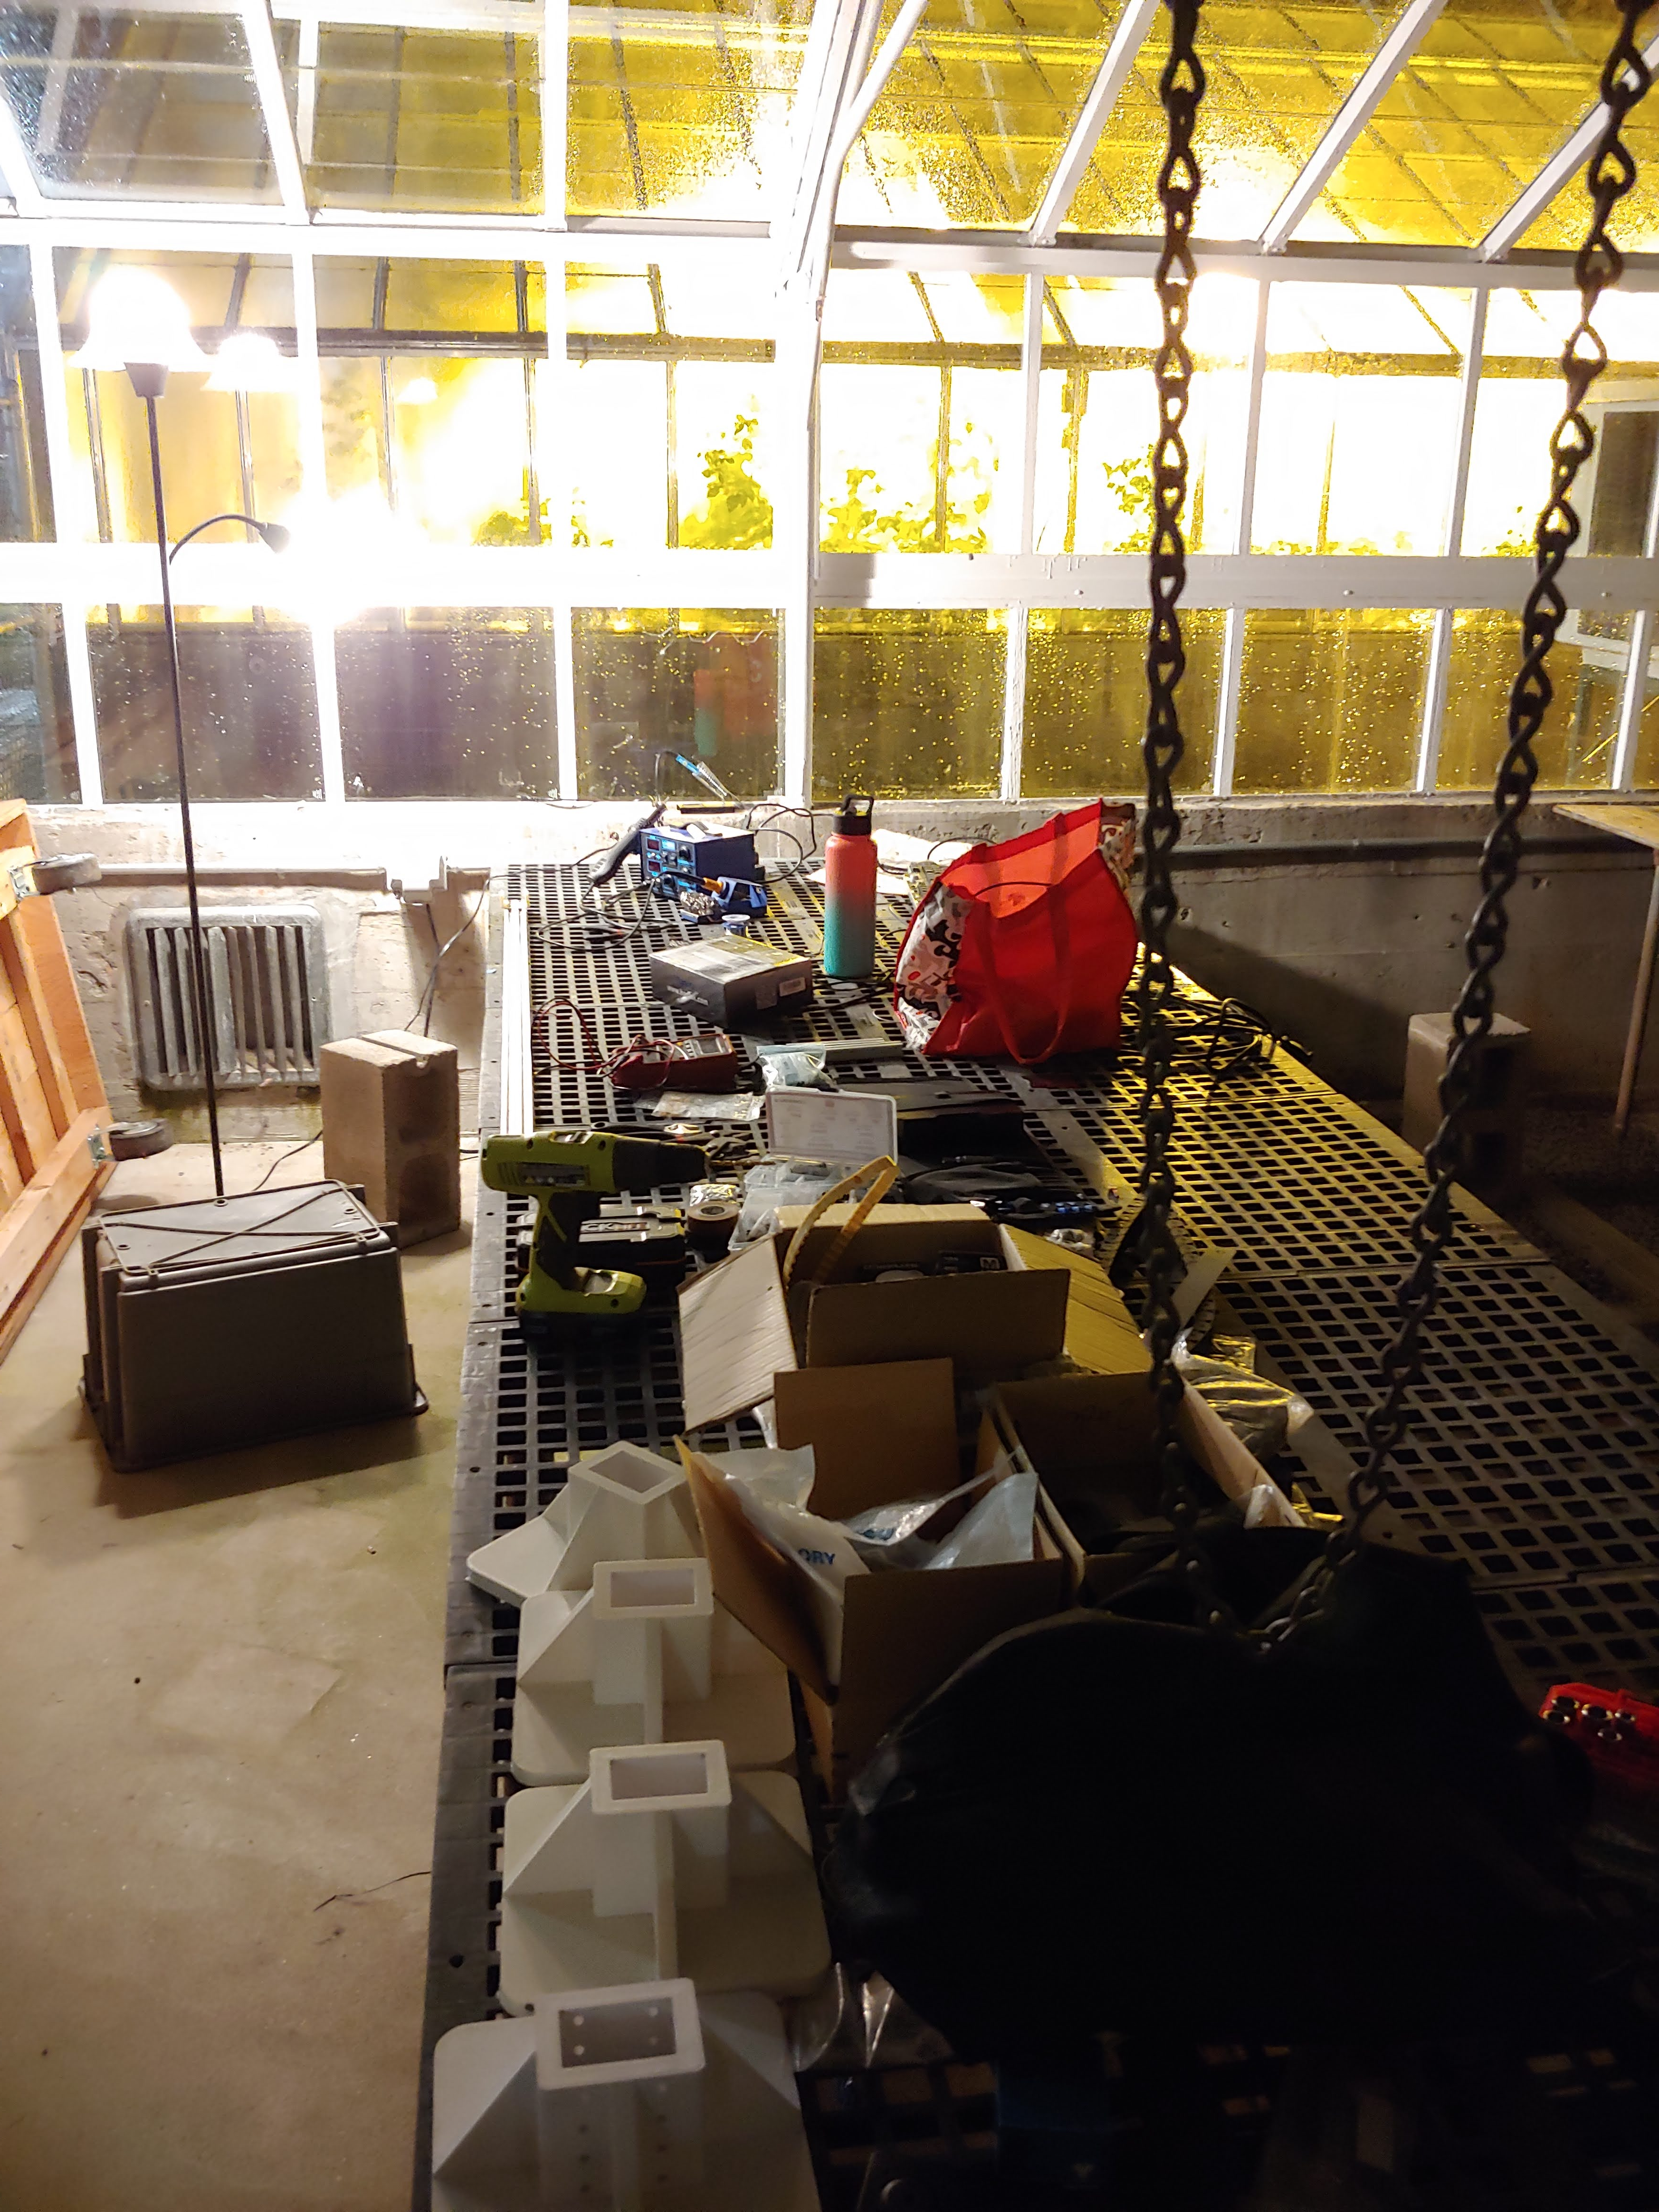
Current Status

Slide 4
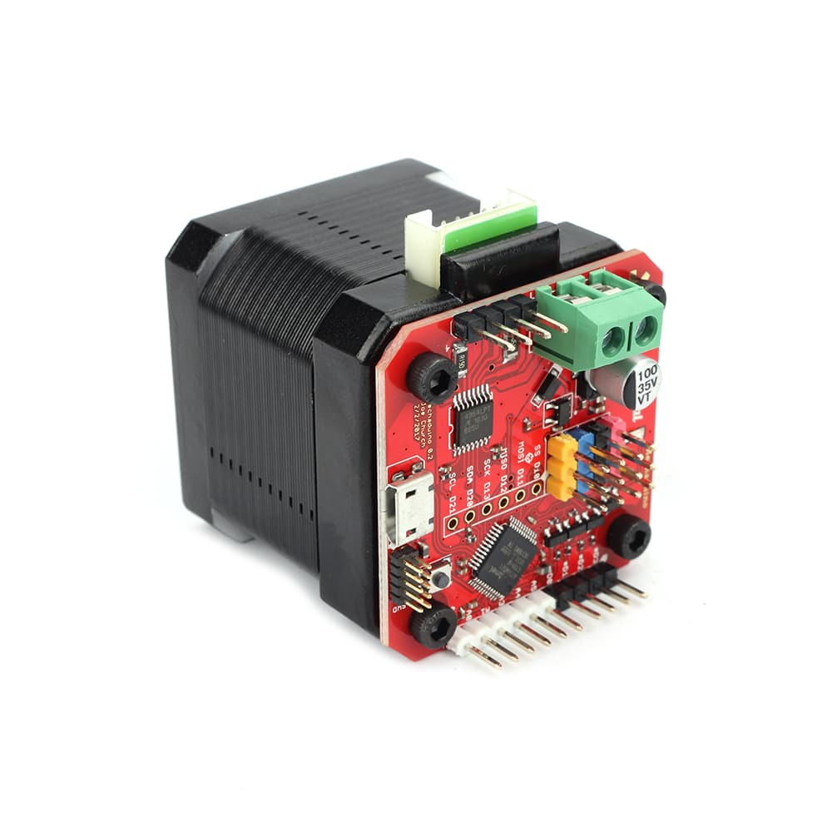
Project Work
Junior Design System Verification
Meeting with teams all this week to assemble / test
Verification for all groups by the end of this week
Looking into integrated stepper drivers
Mechaduino
TMC2209 – TMC2225
Magnetic Feedback encoder

Slide 5
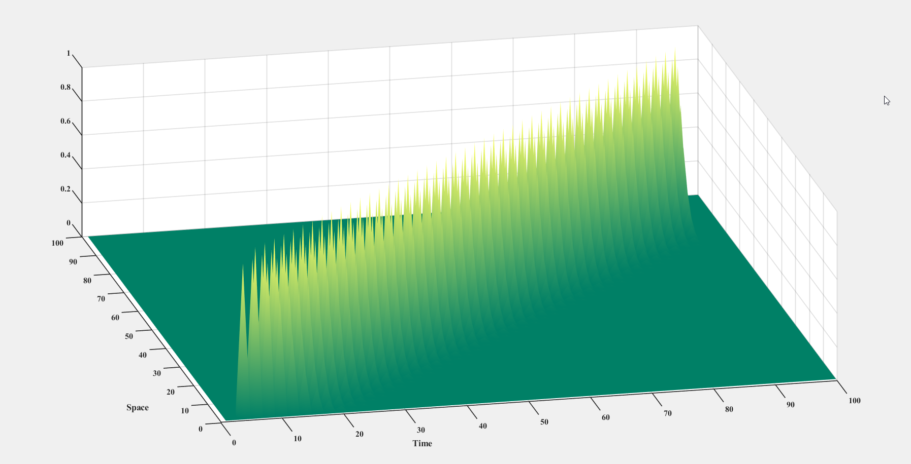
Other Work
Finite Difference Time Domain Method in Adv Electromagnetics
Everything can be boiled down to estimating very small parts of a response and adding them all together
Final few projects

Slide 6
My Plan
Keep up with projects and school work
Start testing full system with Junior Design team
Integrate ESP32 GRBL with control system for next term

